Slide 1
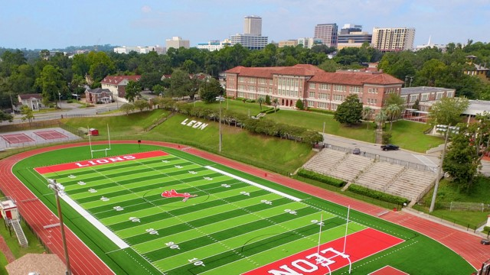
LEON HIGH SCHOOL
Incoming 9th Grade Presentation

Slide 2

Leon High School Administration
Principal – Mr. Bryan
Assistant Principal of Facilities and Athletics – Mr. Bell
Assistant Principal of Attendance – Ms. John
Assistant Principal of Curriculum – Ms. Salvo
Assistant Principal of Student Discipline – Mr. Warfel
Dean of Students – Ms. Agbasoga

Slide 3
Leon Guidance Department
9th Grade Counselor – Ms. Tyson
10th – 12th Grade
  Last Name A-F – Ms. Folmar
  Last Name G-O – Mr. Norris
  Last Name P-Z – Mr. Wentz
Social Worker – Ms. Sawyer
AP/Gifted/ESOL Coordinator – Ms. Hyle

Slide 4
Promotion Requirements
Grade | Minimum Credits | Minimum GPA
8th to 9th | Meet all 8th grade promotion requirements | N/A
9th to 10th | 5 | 1.0
10th to 11th | 10 | 1.5
11th to 12th | 17 | 2.0
12th to Graduation | NEXT SLIDE

Slide 5
Graduation Requirements
2.0 GPA
Passing Algebra EOC Score (3 or higher) – or concordant score
Passing 10th grade ELA FAST Score (3 or higher) - or concordant score
Scholar Diploma Designation
Merit Diploma Designation
Fine Arts Diploma Designation
4 Language Art Credits
4 Mathematics Credits
  Algebra 1
  Geometry
3 Science Credits
  Biology
3 Social Studies Credits
  World History
  US History
  US Govt/Economics
1 Credit HOPE
0.5 Credit Personal Finance
1 Credit Performing or Practical Arts
7.5 Elective Credits of your choice

Slide 6
Required 9th Grade Classes
6 classes – 3.5 required, 2.5 you can pick!
Language Arts – Full Year – 1 Credit
  English 1 or English 1 Honors
Math Course – Full Year – 1 Credit
  Algebra 1 or Algebra 1 Honors
  Geometry Honors
  Algebra 2 Honors
Science Course – Full Year - 1 Credit
  Marine Science or Marine Honors
  Chemistry Honors
Personal Finance or Personal Finance Honors – half year – 0.5 Credit
Intensive Reading – will take an elective spot for anyone who scores in the 10th percentile or below on the 8th Grade PM3 FAST Reading assessment
ESOL Support – potential
ESE Support – potential
Future Options
  TONS of AP Courses – Cores and Electives!
  Dual Enrollment – FSU, TSC, Lively, on-campus
  Current teachers will make recommendations – but ultimately your PM3 and Gradebook data will determine your final placement.

Slide 7
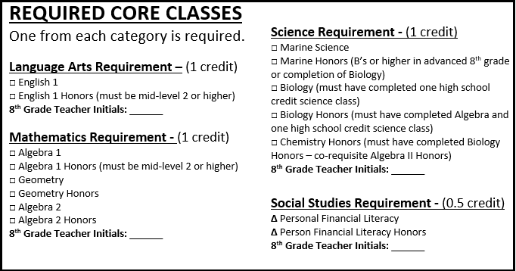
Course Request form - Cores

Slide 8
Elective Courses Options – Pick 2.5
Full Year – 1 Credit options
Semester - 0.5 offerings
  Band
  Orchestra
  Chorus
  Guitar
  Theatre Tech
  Color Guard
  Steel Drum
  Intro to Leadership/SGA
  Leadership Education/JROTC
  Culinary*
  Digital Design*
  Construction*
  Yearbook
  Theatre
  Ceramics
  2D Studio Art 1
  French
  Latin
  Spanish
  HOPE
  Intro to Drumming
  Yoga (can make full year)
  Weight Training (can make full year)
  Team Sports (can make full year)
  Music Fundamentals
  Keyboarding (Piano)
  Principles of Food
  Drama
  Art 2D
  Art 3D
  Tennis (can make full year)
  Pickleball (can make full year)
  Humanities (H)
  Sports Officiating
  Care and Prevention

Slide 9
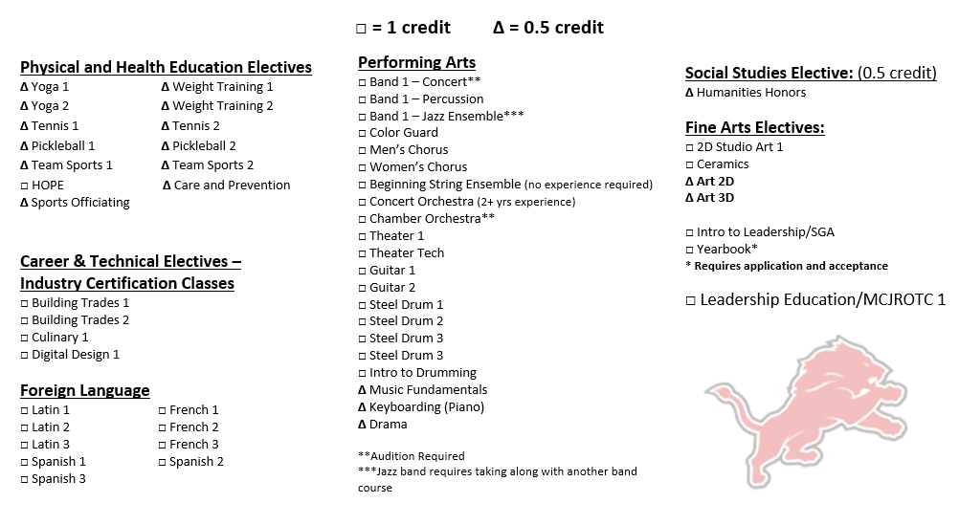
Course Request Form – Electives – Pick 2.5

Slide 10
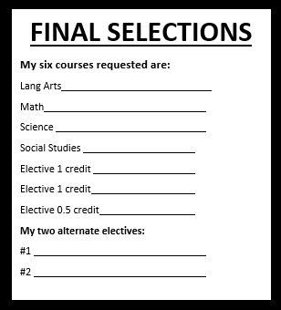
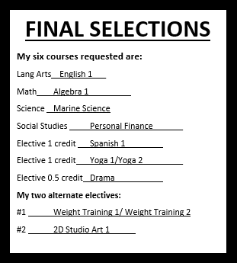
Course Request Form – Final Selections
When you are done picking all your 6 credits – list them in the Final Selection box with your alternative choices. Use a slash to indicate two semester credits together to total one credit – Example: Yoga 1/Yoga 2

Slide 11
Bell Schedule
First Bell 7:25am
1st Period 7:30 – 8:25
2nd Period 8:30 – 9:22
3rd Period 9:27 – 10:19
4th Period 10:24 – 11:16
Lunch 11:16 – 11:55
5th Period 12:00 – 12:52
6th Period 12:57 – 1:50
7th Period 1:55 – 2:45*

Slide 12
Attendance
Tardy Policy
  Every 4th Tardy = Referral
    Lunch Detention
    ISS or loss of off-campus/parking privileges
  16 or more tardies for a quarter – cannot participate in any Dances, Field Trips, or other events determined by administration
Attendance Policy
  Get excused within 3 days of absence
  15 or more absences – excused or unexcused – cannot attend any Dances, Field Trips, or other events determined by administration
  Leon-Attendance@leonschools.net

Slide 13
Lunch/Off-Campus/Parking
All 9th graders – no privileges
NO lunch deliveries to campus
Free Breakfast/Lunch for everyone (this year, TBD for 2025-26)
Something to look forward to!
  Off-Campus Lunch Passes – Juniors and Seniors ONLY
    2.0 GPA
    No Obligations
    No Attendance/tardy concerns
    Privilege can be revoked!
  Parking Passes
    Seniors first – remaining spots go to Juniors, then any leftovers go to Sophomores
    $50 fee
    Privilege can be revoked!

Slide 14
Leon Clubs
Amitie
Anime
Anchor
Art Club/Art Honor Society
Black Student Union
Black History Brain Bowl
Brain Bowl
Chess Club
Computer Science Club
Dance Marathon
Eco Club
English National Honor Society
Fellowship of Christian Athletes (FCA)
Fishing Club
French Honor Society
Future Educators of America
Gaming Club/DND
Garden Club
Gay-Straight Alliance (GSA)
Interact
International Student Organization
Key Club
Model United Nations
Mosaic
Mu Alpha Theta
Fashion Club
Philosophy Club
Pickleball Club
Pierian National Honor Society
Rebus Gestis
Rho Kappa
Science National Honor Society
SGA
Students Demand Action
Thespians
Tri-M Music Honor Society
Volleyball Club
Yarn Club
Get involved!

Slide 15
Leon Sports
Cheerleading
Boys and Girls Cross Country
Boys and Girls Golf
Football
Swimming
Bowling
Volleyball
Beach Volleyball
Boys and Girls Basketball
Boys and Girls Soccer
Boys and Girls Weightlifting
Baseball
Softball
Boys and Girls Track
Wrestling
Flag Football
Tennis
Boys Lacrosse
2.0 GPA Required

Slide 16


Slide 17
Freshman Orientation
SAVE THE DATE
Thursday, August 7th
Cost $20 (includes bag, class t-shirt, lunch)
8:30am – 3:00pm

Slide 18
LeonCurriculum@leonschools.net www.leonschools.net/Leon

